Slide 1


CS 6831 Designing Secure Cryptography
Tom Ristenpart

Slide 2
Cryptographic hash functions
A function H that maps (essentially) arbitrary bit string to
fixed length string of size n
MD5: n = 128 bits
SHA-1: n = 160 bits
SHA-256: n = 256 bits
SHA-512: n = 512 bits
SHA-3: n = 224, 256, 384, 512 bits
M
H
H(M)
Many security properties asked of hash functions

Slide 3
Applications of cryptographic hashing
File comparison
Digital signatures (coming up later)
For message authentication codes
Key derivation
Password hashing

Slide 4
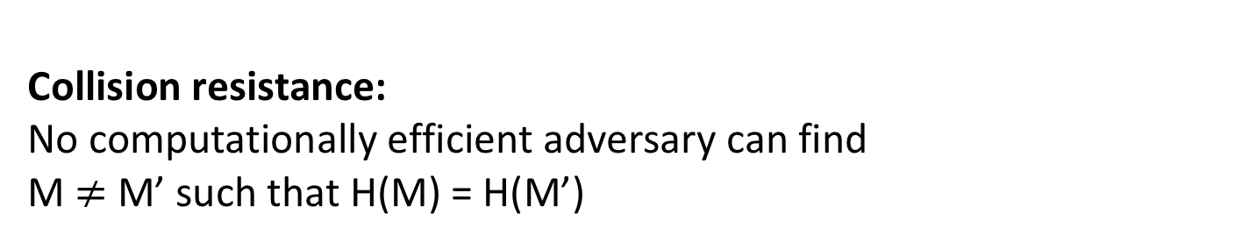
Cryptographic hash functions
MD5: n = 128 bits
SHA-1: n = 160 bits
SHA-256: n = 256 bits
SHA-512: n = 512 bits
SHA-3: n = 224, 256, 384, 512 bits
M
H
H(M)
Collision resistance:
No computationally efficient adversary can find
M $≠$ M’ such that H(M) = H(M’)

Slide 5
Collisions always exist
Domain (usually all strings up to some length)
SHA-256: up to length 2⁶⁴-1
Range {0,1}^{n}
H(M)
M
There exists CR adversary that wins with probability 1 and is efficient
H(M’)
M’
“Human ignorance”:
We can’t figure out what such an adversary is.
Good enough as an assumption
See [Rogaway 06]
M’’
H(M’’)
Not drawn to scale!!!
Pigeonhole principle:
size of domain larger than size of range implies there must be collisions

Slide 6
Birthday attacks
What is best possible security achievable by hash function with output length n bits?
Answer: security is only achievable up to 2^{n/2} hash computations

Slide 7
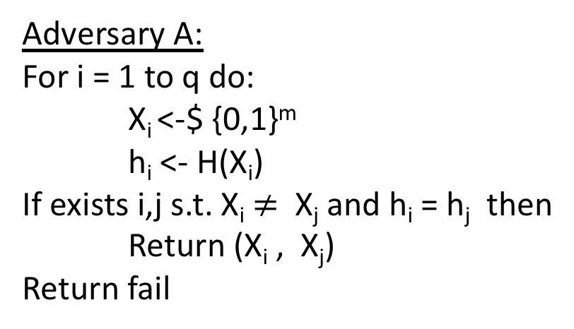
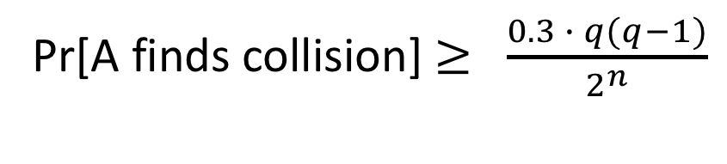
The birthday attack
Let m be some length in domain of hash function H
Adversary A:
For i = 1 to q do:
X_{i} <-$ {0,1}^{m}
h_{i} <- H(X_{i})
If exists i,j s.t. X_{i} $≠$ X_{j} and h_{i} = h_{j} then
Return (X_{i} , X_{j})
Return fail
Same # of domain points
map to each range point
If H is regular then probability of success is exactly birthday probability
Pr[A finds collision] $≥$ $\frac{0.3 ∙ q(q−1)}{2^{n}}$

Slide 8

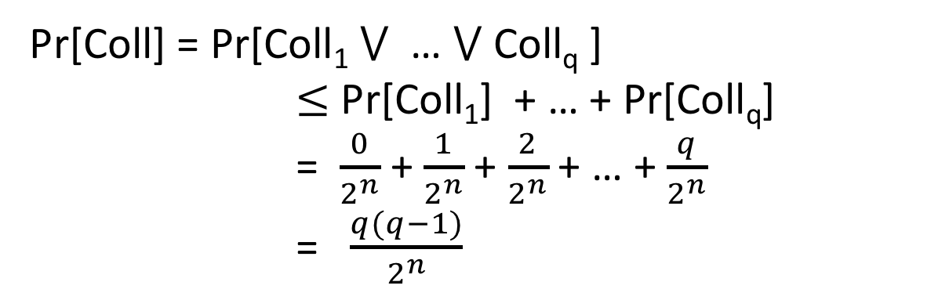
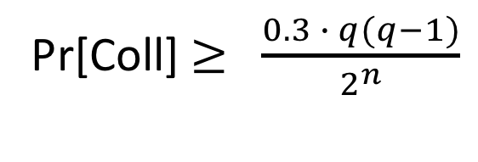
The birthday problem
Choose q values Y₁,…,Y_{q} from {0,1}^{n} at random. What is probability that two are the same?
Let Coll_{i} be event that Y_{i} = Y_{j} for some j < i
Pr[Coll] = Pr[Coll₁ $⋁$ … $⋁$ Coll_{q} ]
$≤$ Pr[Coll₁] + … + Pr[Coll_{q}]
= $\frac{0}{2^{n}}$ + $\frac{1}{2^{n}}$ + $\frac{2}{2^{n}}$ + … + $\frac{q}{2^{n}}$
= $\frac{q(q−1)}{2^{n}}$
Another proof shows that if q $≤$ 2^{(n+1)/2}
Pr[Coll] $≥$ $\frac{0.3 ∙ q(q−1)}{2^{n}}$

Slide 9
Birthday attack run times
MD5: n = 128 bits
SHA-1: n = 160 bits
SHA-256: n = 256 bits
2⁶⁴ MD5 computations
2⁸⁰ SHA-1 computations
2¹²⁸ SHA-2 computations
2⁶⁴ too small by today’s standards!
Bitcoin network computes about 2⁶⁵ SHA-256 hashes per second
https://blockchain.info/charts/hash-rate

Slide 10
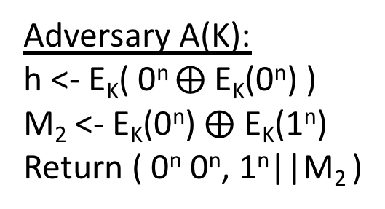
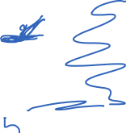
CBC-MAC is not CR
M₁
M₂
M₃
Key was secret in CBC-MAC.
But hash functions are publicly computable.
One idea is to use a random, public K value known to attacker.
E_{K}
E_{K}
E_{K}
h
How do we efficiently find collisions?
Adversary A(K):
h <- E_{K}( 0^{n} $⨁$E_{K}(0^{n}) )
M₂ <- E_{K}(0^{n}) $⨁$ E_{K}(1^{n})
Return ( 0^{n} 0^{n}, 1^{n}||M₂ )
Universal hashes are also not CR

Slide 11
Two-step MD design paradigm for hash functions
Compression
Function
Hash Function
d
*
n
Domain
extension
transform
n
f
n
H
Example: domain extension using “Merkle-Damgard with strengthening”
M1
M2
M3||10^{r} || <|M|>
Used in
MD-x, SHA-1,
SHA-256, …
f
f
f
IV
H(M)
r is minimal number of zeros needed to get to multiple of block size
IV is a fixed constant. Not randomly chosen.

Slide 12
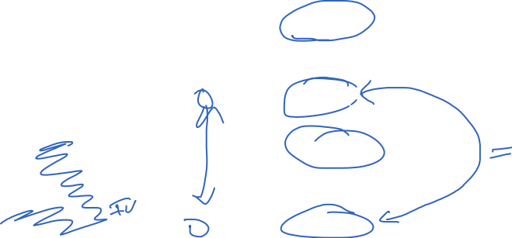
Merkle-Damgard CR preservation result
M1
M2
M3||10^{r} || <|M|>
f
f
f
IV
H(M)
M1’
M2’
M3’||10^{r} || <|M’|>
f
f
f
IV
H(M’)

Slide 13
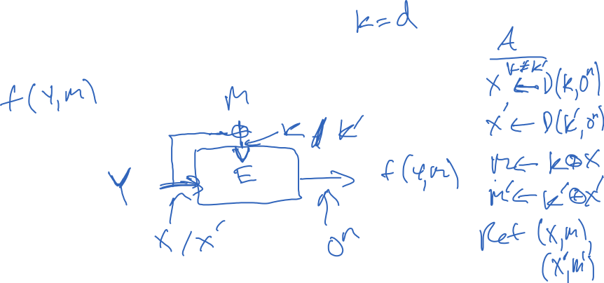
Building compression functions
Want:
Given:
Notes:
Examples of broken uses of block cipher. Simple m + z. E(m,z) or E(z,m).

Slide 14
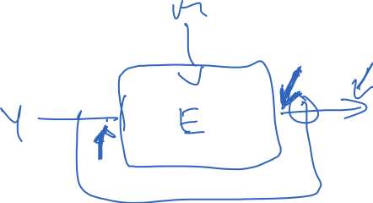
Building compression functions
Want:
Given:

Slide 15
Ideal cipher model
Want:
Given:
Model block cipher as ideal:
Each key selects independent random permutation
BC(k,n) = set of all block ciphers with k bit keys and n bit blocks
All algorithms given oracle access to ideal cipher
Notes:
Examples of broken uses of block cipher. Simple m + z. E(m,z) or E(z,m).

Slide 16
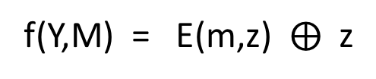

Davies-Meyers compression function
M
64 other “PGV” compression functions
12 have security profile similar to DM
See [Shrimpton, Rogaway 2002]
f(Y,M) = E(m,z) $⨁$ z
Z
E
Notes:
Examples of broken uses of block cipher. Simple m + z. E(m,z) or E(z,m).

Slide 17

From [Rogaway, Shrimpton 2002]

Slide 18
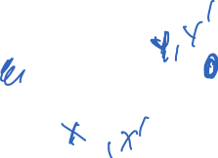
Davies-Meyers compression function
M
64 other “PGV” compression functions
12 have security profile similar to DM
See [Shrimpton, Rogaway 2002]
f(Y,M) = E(m,z) $⨁$ z
Z
E
Notes:
Examples of broken uses of block cipher. Simple m + z. E(m,z) or E(z,m).

Slide 19
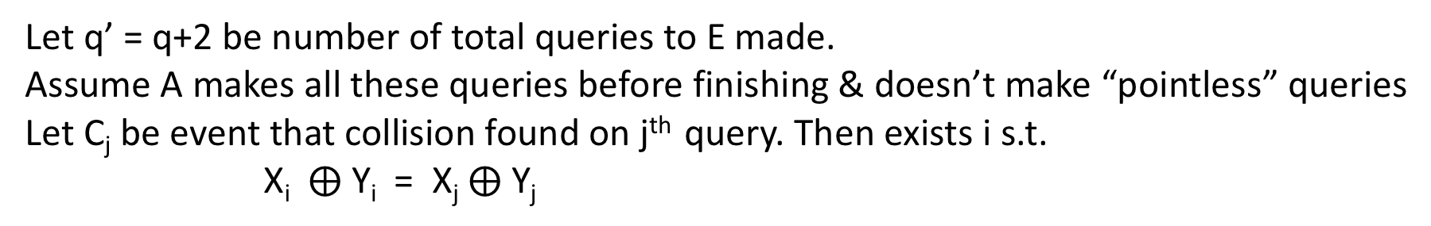
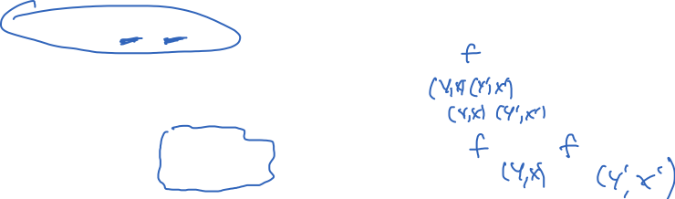
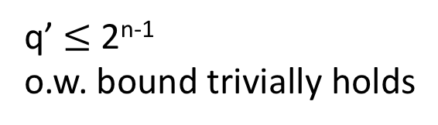
Let q’ = q+2 be number of total queries to E made.
Assume A makes all these queries before finishing & doesn’t make “pointless” queries
Let C_{j} be event that collision found on j^{th} query. Then exists i s.t.
X_{i} $⨁$ Y_{i} = X_{j} $⨁$ Y_{j}
q’ $≤$ 2^{n-1}
o.w. bound trivially holds

Slide 20
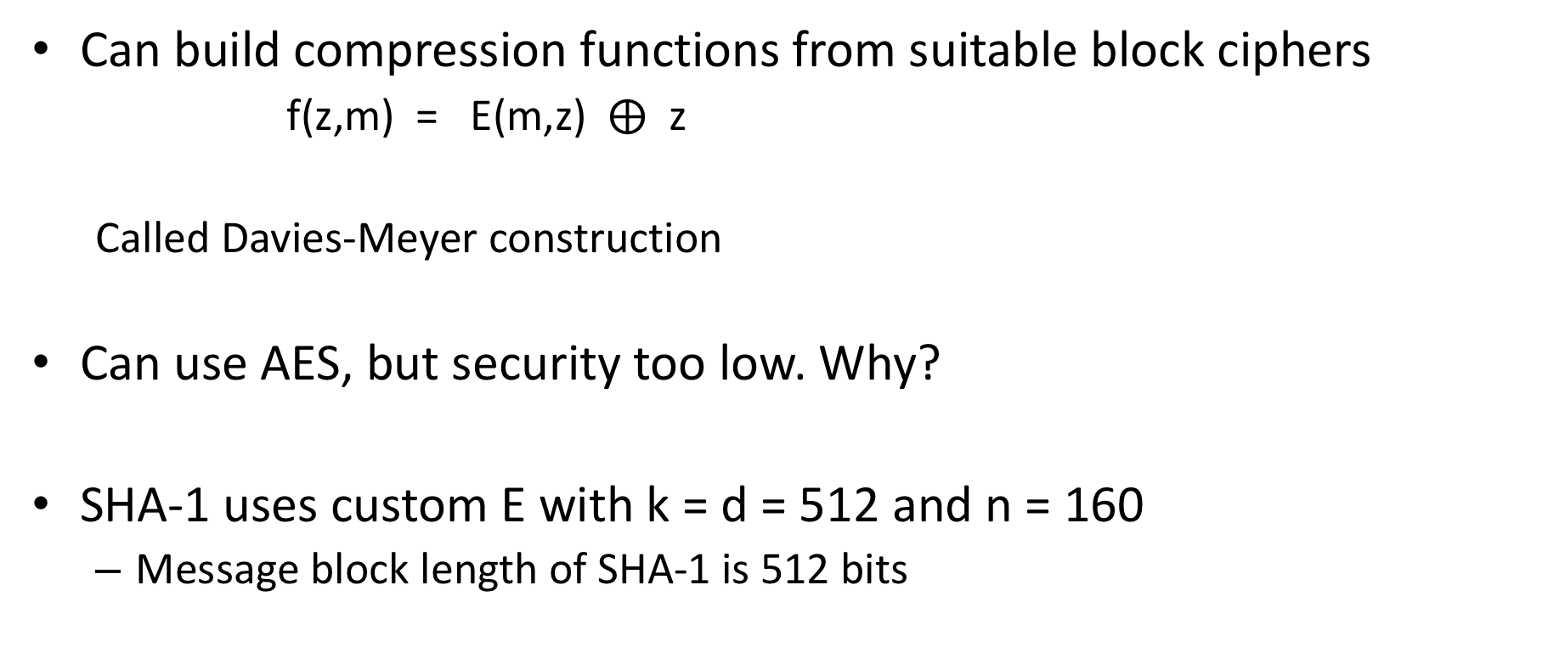
Building compression functions
Can build compression functions from suitable block ciphers
f(z,m) = E(m,z) $⨁$ z
Called Davies-Meyer construction
Can use AES, but security too low. Why?
SHA-1 uses custom E with k = d = 512 and n = 160
Message block length of SHA-1 is 512 bits
Notes:
Examples of broken uses of block cipher. Simple m + z. E(m,z) or E(z,m).

Slide 21
SHA-1 compression function
Expand 512-bit message into
W₁,…,W₈₀ strings of length 32 bit values
(Think of this as “key schedule”)
Chaining variable is 160 bits, 5 32-bit values
A , B , C , D , E
F(B,C,D) function that changes over rounds:
0-19: (B and C) or ((not B) and D)
20-39: B xor C xor D
40-59: (B and C) or (B and C) or (C and D)
60-79: B xor C xor D
Constants K₁ , … , K₈₀ differ across rounds

Slide 22
Cryptanalysis results
2004: Full break of MD5 announced by Xiaoyun Wang and co-authors
MD5 is easy to break now. You can download programs to do it on your laptop
2005: Announced faster than 2⁸⁰ attack against SHA-1 by Wang et al.
Not practical to run (2⁶⁹ estimated cost)
2017: CWI and Google announce first demonstrated collision

Slide 23

SHAttered attack
Chosen prefix P. Find two pairs of message blocks
M₁ , M₂ and M₁’ , M₂’ such that for any suffix S:
SHA-1(P || M₁ || M₂ || S) = SHA-1(P || M₁’ || M₂’ || S)
Referred to as a identical-prefix collision attack
How? Pick P, find M₁ and M₁’ that form near-collision on chaining variable. Then complete collision by finding M₂ and M₂’
They show how to extend to build colliding PDF files

Slide 24
SHAttered attack
Required 2^{63.1} SHA-1 compression function applications
100,000x faster than birthday attack (2⁸⁰)

Slide 25
Fallout of attack
SVN repositories can be broken (DoS attack)
- Checking in the two SHAttered PDFs corrupts repo
Linus Torvalds misunderstands security…
(to paraphrase) GIT’s ok because we can trust everyone
https://plus.google.com/+LinusTorvalds/posts/7tp2gYWQugL
Marc Stevens & Dan Shumow (Microsoft) developed counter-cryptanalysis tool
Way to detect if a particular file is one half of colliding pair
Deployed at several large companies
Ongoing migration away from SHA-1 to SHA-256 / SHA-3

Slide 26
SHA-3 competition
SHA-1 attacks prompted NIST competition for new hash function 2007-2012
51 submissions; 14 proceeded to round 2; 5 finalists
KECCAK selected as winner
Bertoni, Daemon, Peeters, Van Assche

Slide 27
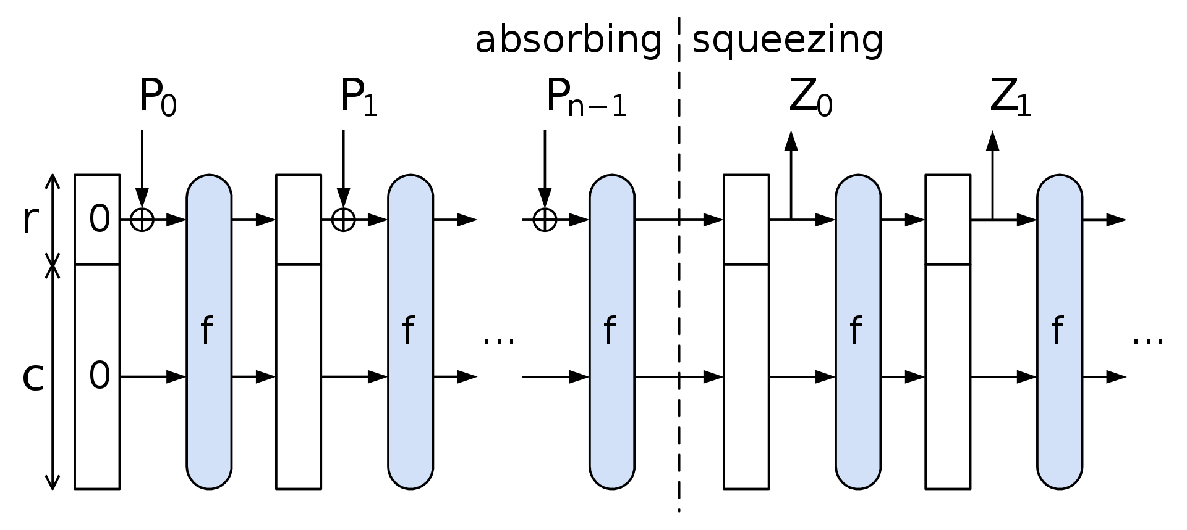

Sponge construction

Slide 28
Towards using hash functions as PRFs
Hash functions don’t have keys. So we must key them somehow to treat as PRFs.
K || M
H
This is vulnerable to length extension attacks

Slide 29
Building PRFs with hash functions: HMAC
Use a hash function H to build a MAC. K is a secret key
ipad != opad are constants
K ipad || M
H
K opad || h
H
T
This is slight simplification, assuming |K| less than block length of H
HMAC-SHA-1, HMAC-SHA-256, etc.

